Slide 1
Distributed Systems: Scaling web applications
Diego Méndez y David Méndez

Slide 2
What is a Distributed System?
A distributed system is composed of machines that are spread around a network to achieve some task.
Examples of distributed systems:
Web browsers
Instagram
Doordash
Amazon
Netflix
Dropbox
Notes:
A distributed system is a group of individual computing elements working together so it seems it is one single coherent system to its user.
An example of a distributed system is an online multiplayer game.

Slide 3
Key characteristics of Distributed Systems
Scalability: ability to handle efficiently the demands of the system . This usually means to handle more users, data, transactions, or request without affecting the user experience. Scalability is measured in terms of:
throughput: number of operations processed per second
latency: total time that an operation takes to complete in a system
Resiliency: a distributed system is resilient when it can continue to do its job even when failure occurs. If a distributed system is not resilient, it can affect the system’s availability.

Slide 4
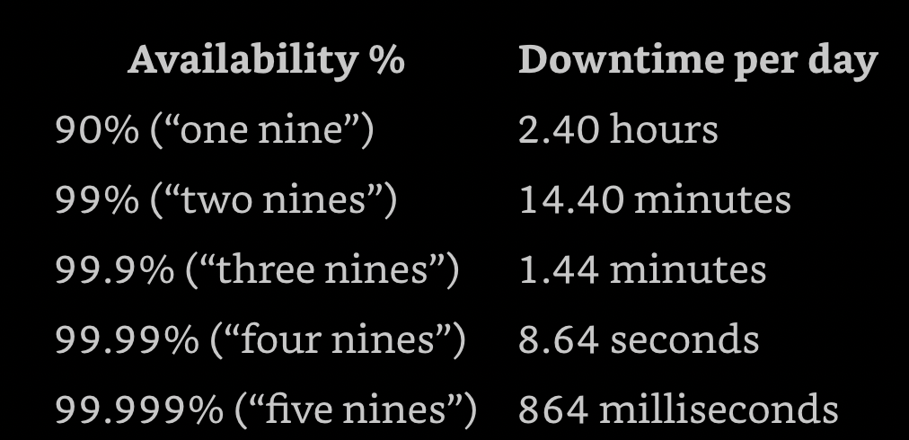
Availability Stats

Slide 5
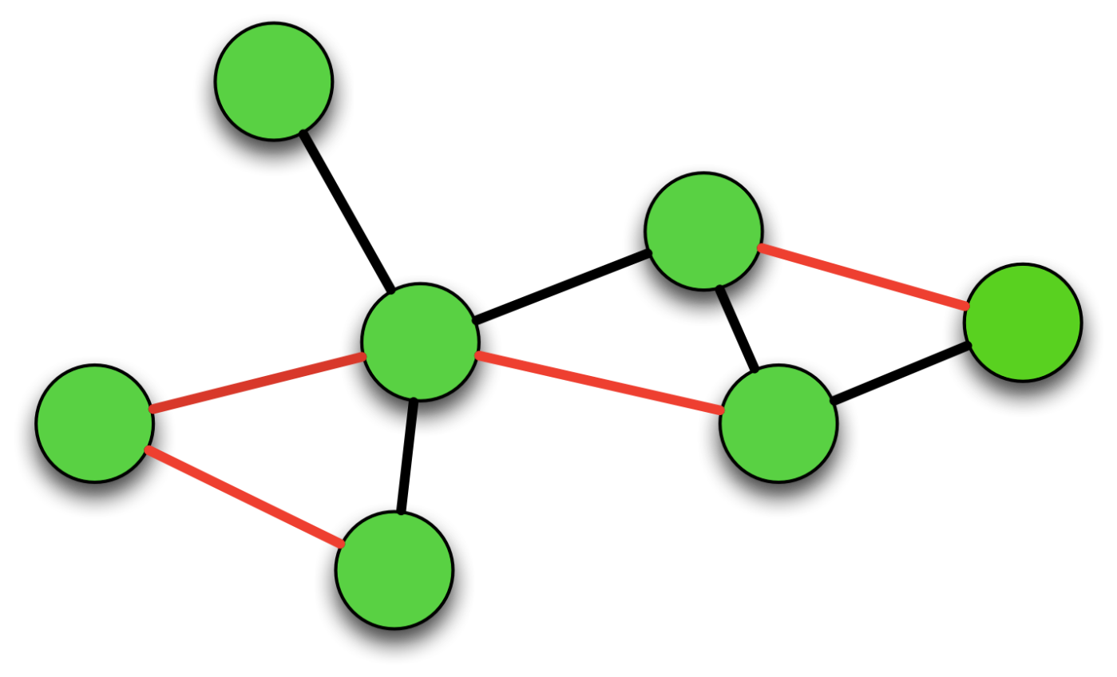
Key characteristics of Distributed Systems
3. Coordination refers to the part of a distributed system that handles the communication and cooperation between processes. It is what makes a distributed system seem as a whole.

Slide 6
III. Vertical scaling
What is vertical scaling?
Vertical scaling refers to scaling by adding more power (e.g. CPU, RAM) to an existing machine (also described as “scaling up”).

Slide 7
Horizontal Scaling
What is horizontal scaling?
Horizontal scaling means scaling by adding more machines to your pool of resources. Also referred as scaling out.

Slide 8
Pros and Cons of Vertical Scaling
Pros:
Vertical scaling is very simple and straight forward as the entire data is in a single server. So, there is no risk of managing multiple instances simultaneously.
For each update, you have more memory power and speedy RAM.
There is no need for any code change during scaling up. No need to change the implementation also.
Cons:
It may fail to respond to simultaneous multiple requests.
More downtime is a higher possibility if the server exceeds the specified load.
It may be more expensive, and the hardware resources may also be costly.

Slide 9
Pros and Cons of Horizontal Scaling
Pros:
Cheaper compared to vertical scaling.
It ensures better performance and can lessen the load.
Compared to vertical screening, the downtime chances are very less.
Fault tolerance is better.
Better resilience
Cons:
Making the joins are quite difficult as horizontal connections involve more cross-server communications.
Less consistency. So, it may not be ideal for related banking transactions or something needed to be executed simultaneously
We may not be able to categorize each of the features to a specific server. For example, the server for images may sometimes take more space than what is available in a single server.

Slide 10
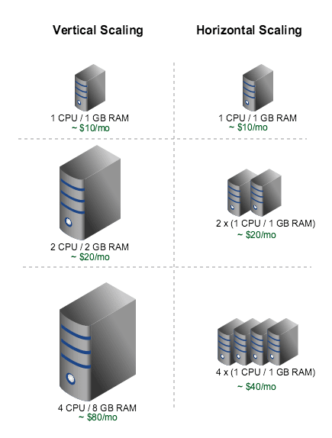
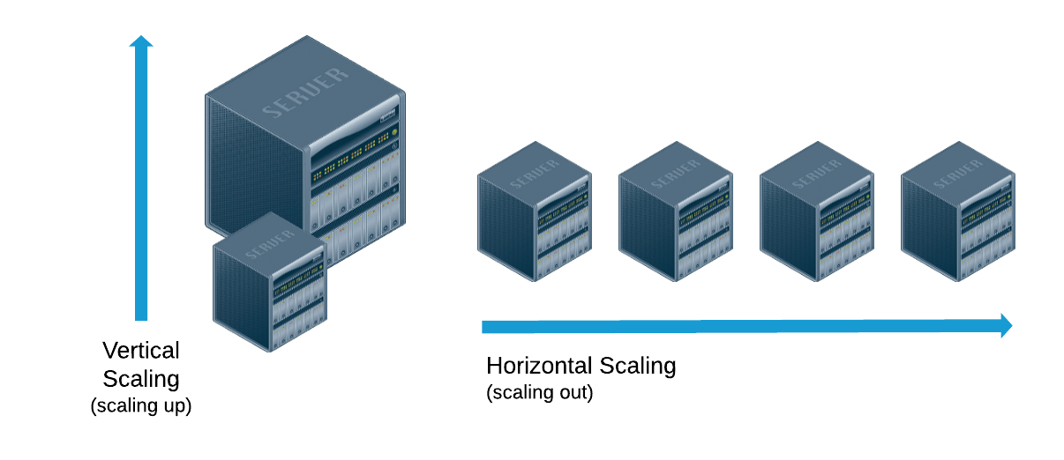
Scaling

Slide 11
V. State
What is state? State is equal to data
Stateful: a system is said to be stateful if it remembers data.
Stateless: a system is said to be stateless if it does not remembers data.
In terms of scalability, we want our servers to be stateless. This way, we can scale horizontally.
Sticky sessions: A stateful system that uses sticky sessions is a system that always directs the user to the same server. For example, the first time User A made a request he was sent to Server A, therefore the user will always be directed to server A.

Slide 12
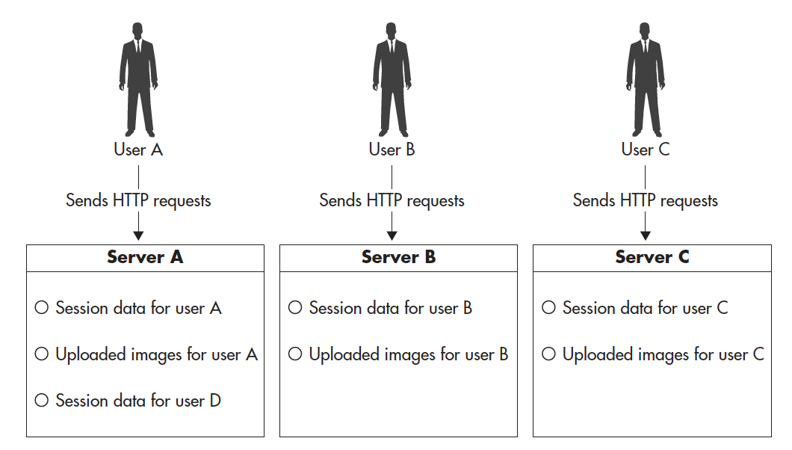
Stateful Example

Slide 13
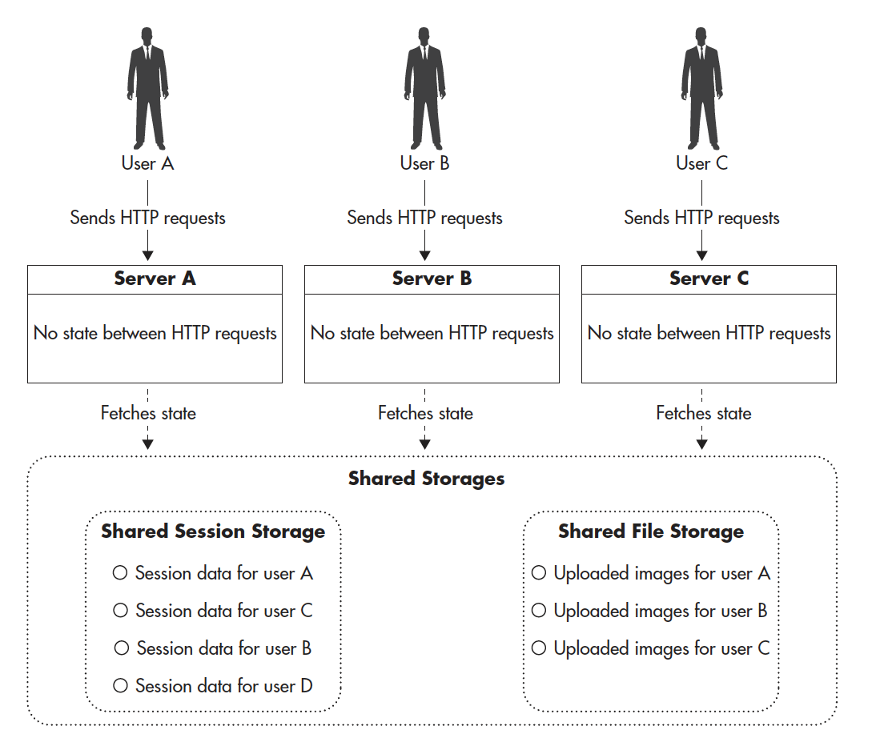
Stateless Example

Slide 14
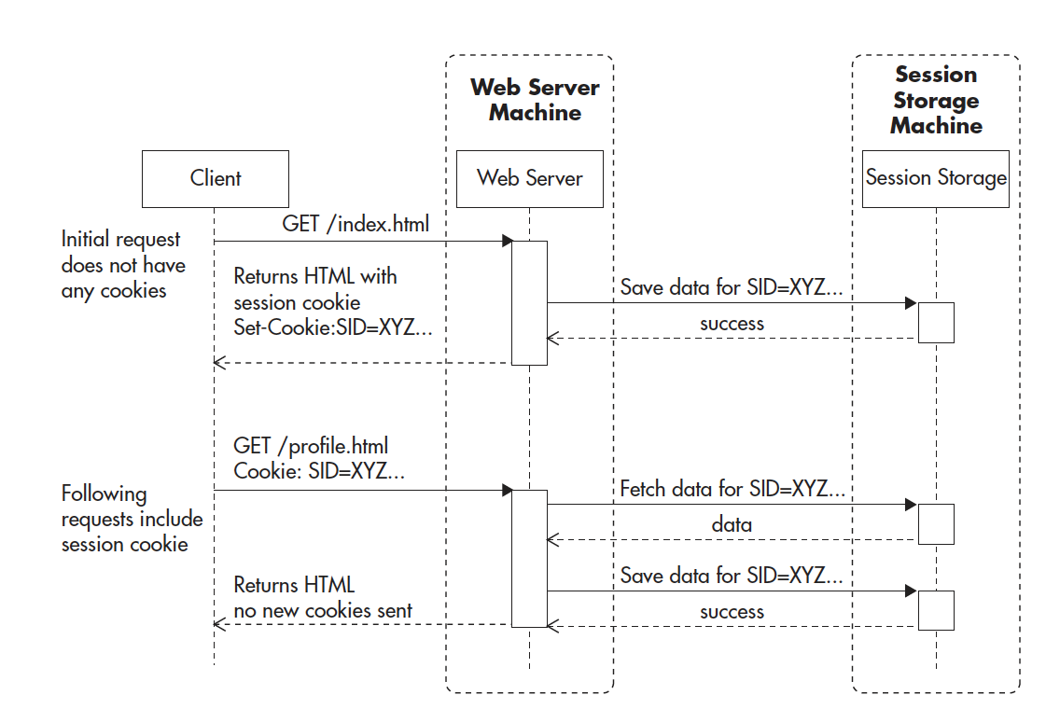
Why having a stateless system allow us to scale horizontally?
Having stateless servers allow us to scale horizontally because each server is the same.
Therefore, we want to delegate our state to external storages.

Slide 15
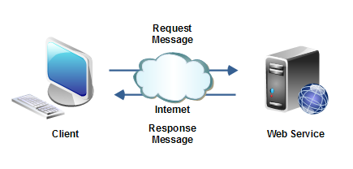
Components of Distributed Systems
Web service(s): service(s) that implement business logic. These services are hosted on servers.

Slide 16
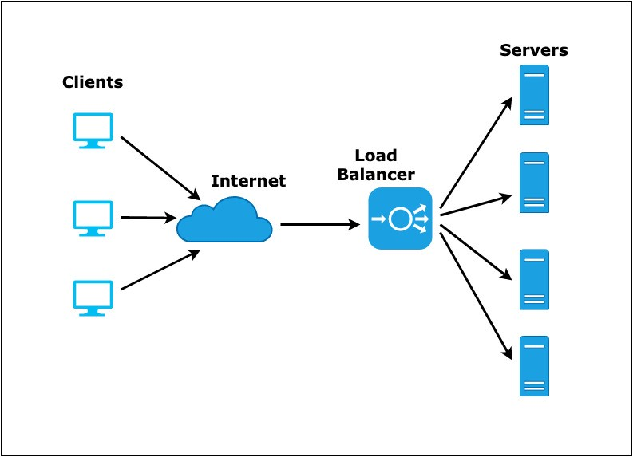
IV. Components of Distributed Systems
Load balancer: component that distribute traffic evenly among multiple servers.

Slide 17
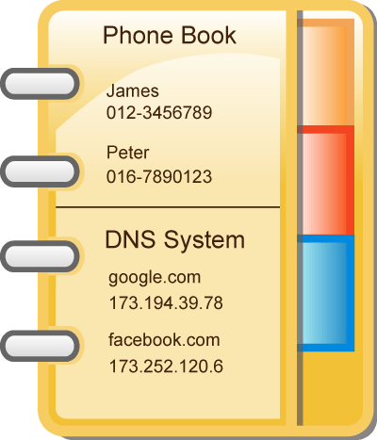
Components of Distributed Systems
DNS: Domain Name System is a service that translates the name of a website or a domain name to an ip address. When you type “google.com” on your browser, a DNS is translating “google.com” to an ip address so you can connect to google.

Slide 18
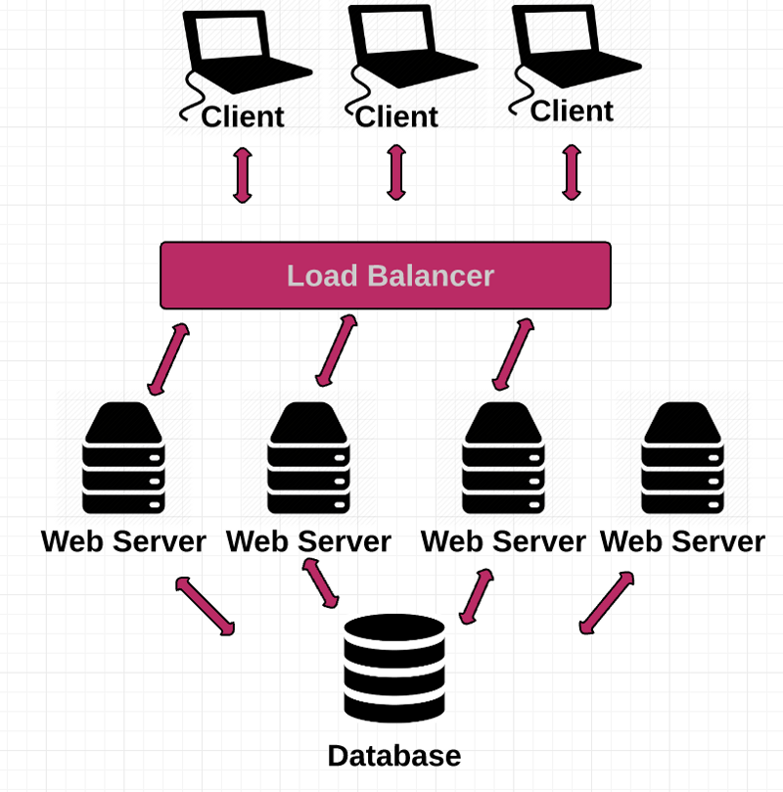
Components of Distributed Systems
Data Stores: This is where all of our state/data is stored. Data is stored in SQL databases or NoSQL databases. Scaling databases is the most difficult part of scaling.

Slide 19
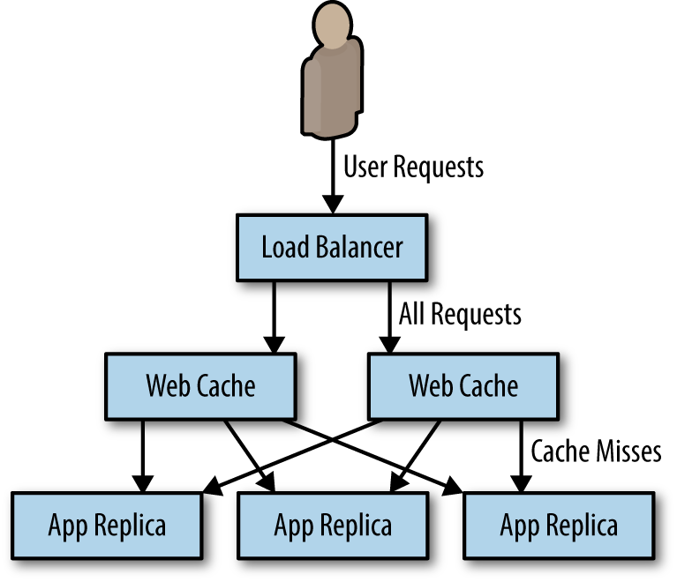
Components of Distributed Systems
cache servers: focused on reducing the latency of requests by serving previously generated content.

Slide 20
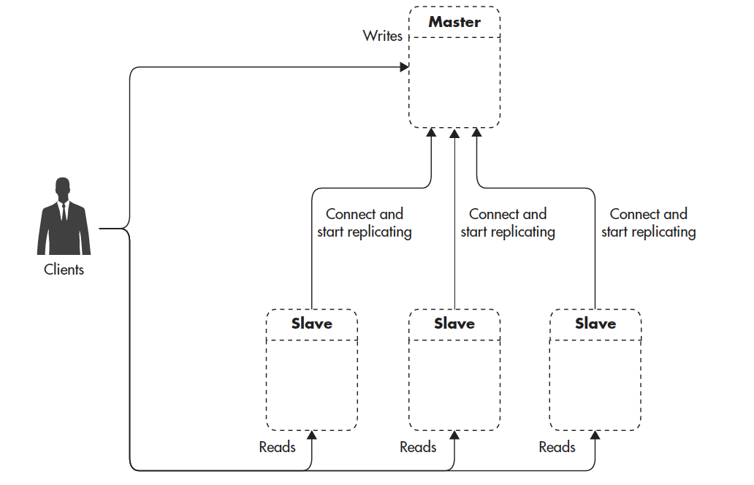
VII. Scaling Databases
Replication: is when you have various copies of a central database.
The challenge of replication is to keep all databases state synchronized.

Slide 21
Monolith vs Microservices
Monolith architecture: entire business logic in one codebase.
Better for small teams of developers.
Microservice architecture: decoupling business logic by services.
Better for scaling services independently.

Slide 22
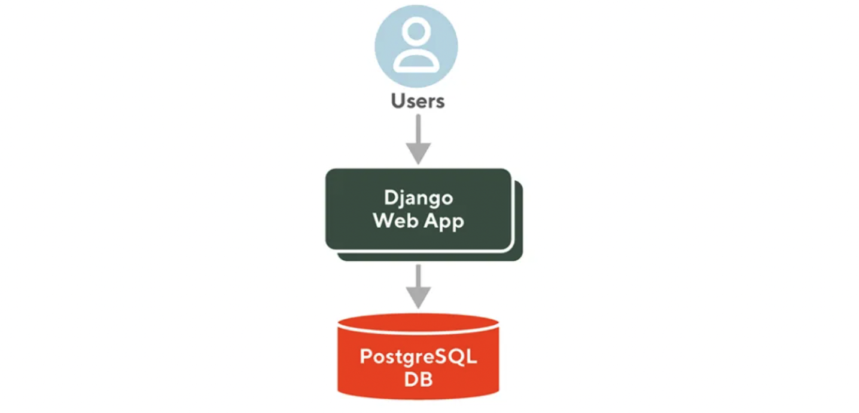
Doordash Monolith Architecture

Slide 23
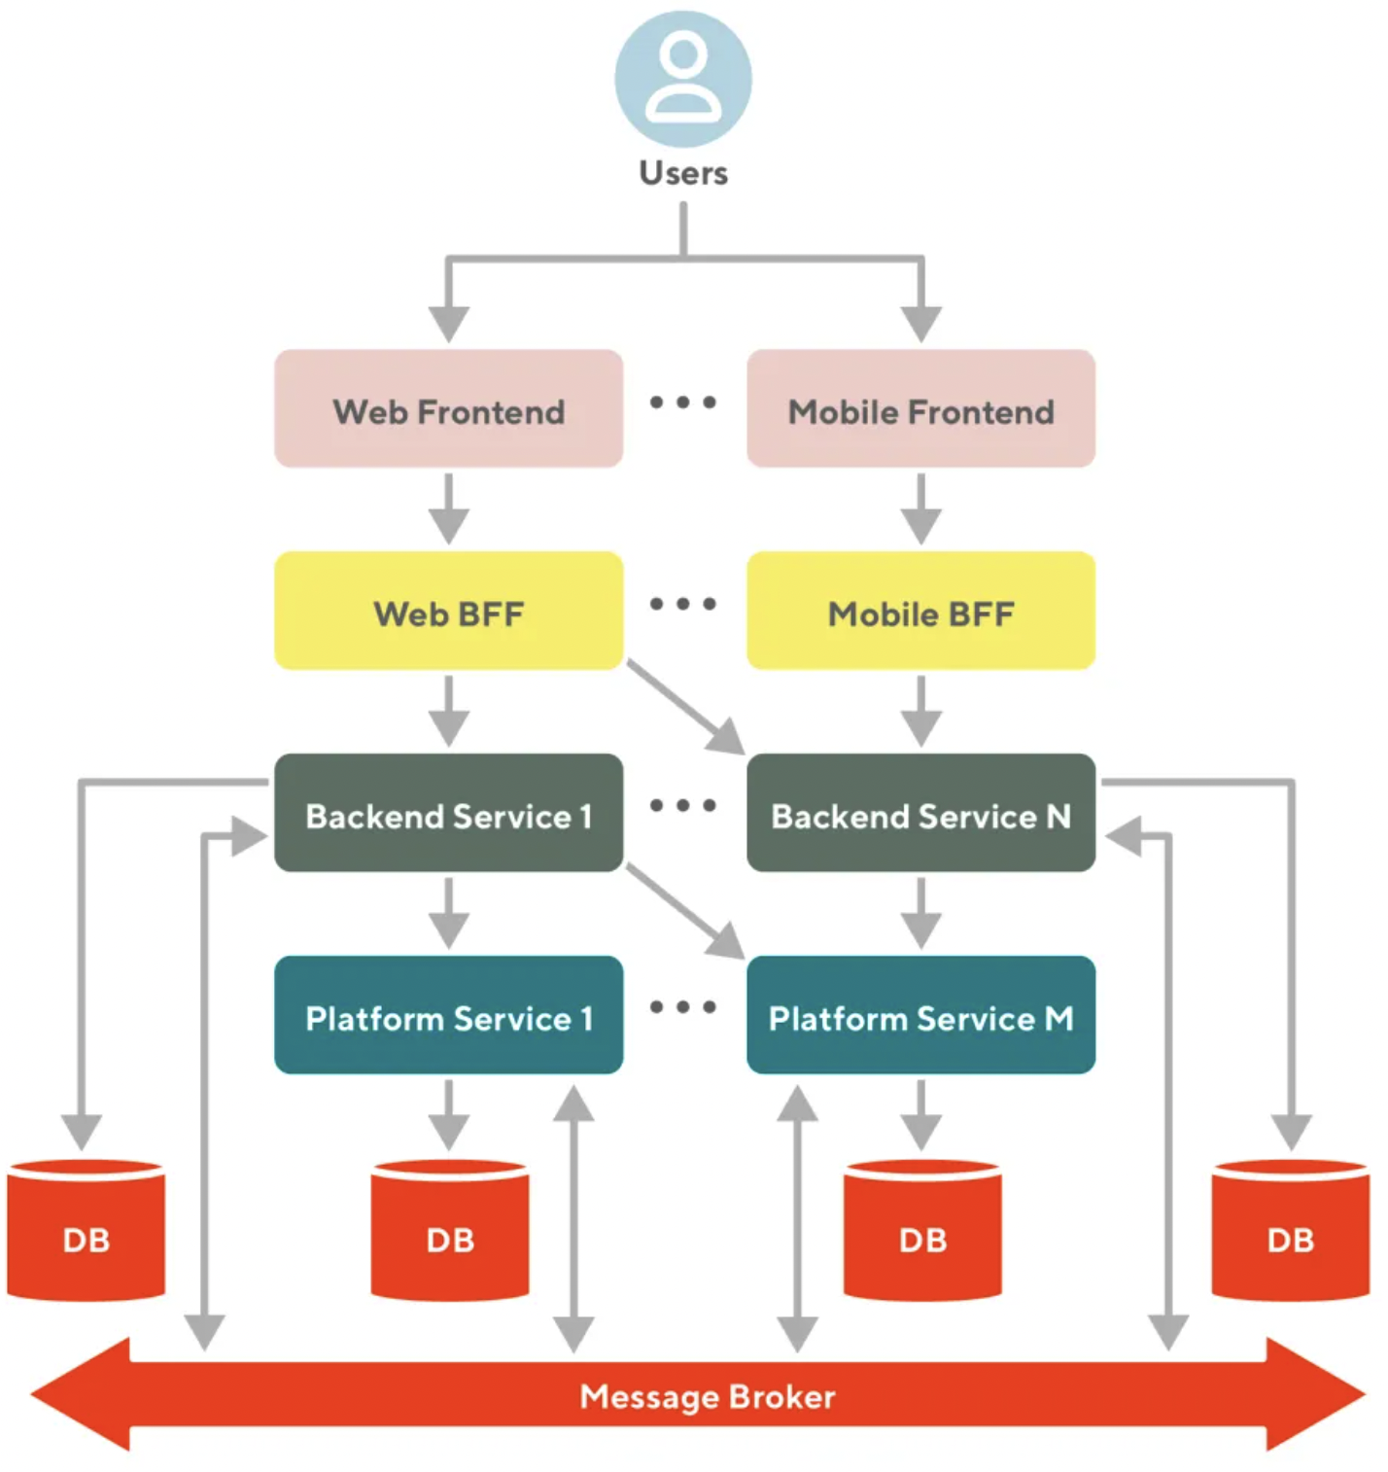
Doordash Microservice Architecture

Slide 24
How to make applications scale horizontally?
Use of load balancers
Decoupling your application to different modules (services)
Make your web servers/services stateless
Apply replication to your database
Use of cache servers

Slide 25
X. References
VITILLO, R. O. B. E. R. T. O. (2021). Understanding distributed systems: What every developer should know about large distributed.. ROBERTO VITILLO, 8-18.
Ejsmont, A. (2015). Web scalability for Startup Engineers: Tips & Techniques for Scaling Your Web Application. McGraw-Hill Education, 22-26.
Gibb, R. (2019, July 27). What is a distributed system? how a ... - stackpath blog. StackPath. Retrieved February 27, 2022, from https://blog.stackpath.com/distributed-system/.
van Steen, M.(2012). Chapter 01: Introduction. Distributed Systems Principles and Paradigms(p. 1-28). VU Amsterdam. https://u.cs.biu.ac.il/~franka2/download/ds590/pdfs/notes.01.pd.
Tyagi, A. (2021, December 13). How to scale a distributed system. freeCodeCamp.org. Retrieved February 28, 2022, from https://www.freecodecamp.org/news/how-to-scale-a-distributed-system/
Celozzi, C. (2020, December 2). How Doordash transitioned from a code monolith to microservices. DoorDash Engineering Blog. Retrieved March 26, 2022, from https://doordash.engineering/2020/12/02/how-doordash-transitioned-from-a-monolith-to-microservices/

Slide 26
VITILLO, R. O. B. E. R. T. O. (2021). Understanding distributed systems: What every developer should know about large distributed.. ROBERTO VITILLO, 8-18.
Ejsmont, A. (2015). Web scalability for Startup Engineers: Tips & Techniques for Scaling Your Web Application. McGraw-Hill Education, 22-26.
Gibb, R. (2019, July 27). What is a distributed system? how a ... - stackpath blog. StackPath. Retrieved February 27, 2022, from https://blog.stackpath.com/distributed-system/.
van Steen, M.(2012). Chapter 01: Introduction. Distributed Systems Principles and Paradigms(p. 1-28). VU Amsterdam. https://u.cs.biu.ac.il/~franka2/download/ds590/pdfs/notes.01.pd.
Tyagi, A. (2021, December 13). How to scale a distributed system. freeCodeCamp.org. Retrieved February 28, 2022, from https://www.freecodecamp.org/news/how-to-scale-a-distributed-system/
Celozzi, C. (2020, December 2). How Doordash transitioned from a code monolith to microservices. DoorDash Engineering Blog. Retrieved March 26, 2022, from https://doordash.engineering/2020/12/02/how-doordash-transitioned-from-a-monolith-to-microservices/

